Slide 1


YELLOW TAXI FARE PREDICTION
BIG DATA FOR BUSINESS
-HADOOP HEROES
Fare Predictions for Enhanced User Satisfaction in New York City
10th November, 2023

Slide 2

GROUP MEMBERS
1
Sri Venkata Likhitha Duggi- Feature engineering, algorithm implementation.
2
Haritha Karna- Initial data cleaning, PARQUET to CSV, PowerPoint.
3
Akhil Vayunandan Reddy Ankireddypalli - Business questions, data flow, presentation, YouTube upload.
4
Sree Krishnakanth Gurram - Data preprocessing, feature engineering, SQL exploration.

Slide 3

YELLOW TAXI FARE PREDICTION
Introduction
In this project, we leverage the power of PySpark to predict fare amounts for Yellow Taxi trips in New York City. Employing advanced analytics and machine learning techniques, our aim is to enhance accuracy in fare predictions, offering valuable insights for both passengers and service providers in the dynamic urban landscape.

Slide 4
Our core objective is to create a predictive model for accurately estimating trip fare prices. By leveraging source and destination details, trip distance, historical extra charges, passenger count, and airport involvement, this solution aims to provide reliable fare predictions, benefiting both passengers and ride-sharing services.
Business Problem

Slide 5
ENHANCING USER EXPERIENCE
In the competitive ride-sharing market, the capability to provide reliable fare predictions sets services apart, attracting and retaining customers through transparent and trustworthy experiences.
SERVICE TRANSPARENCY
Fair predictions enhance the transparency of pricing structures, building trust between service providers and users.
Motivation

Slide 6
Navigating Data Challenges
Utilize historical trip records for modeling.
Incorporate features like pickup/drop-off locations, distance, surcharges, and passenger count.
Build robust pricing algorithms using the identified features.
Implement machine learning models such as regression and decision trees.
Leverage predictive modeling to make accurate fare predictions.

Slide 7

Dataset
Dataset Source: TLC Trip Record Data for yellow and green taxis, and For-Hire Vehicle (FHV) trip records.
Attributes Captured:Includes pick-up/drop-off dates/times, locations, distances, fares, rate, airport fee, and passenger counts.
Data Provenance: Collected and provided to the NYC Taxi and Limousine Commission (TLC) by authorized technology providers under the Taxicab & Livery Passenger Enhancement Programs (TPEP/LPEP).

Slide 8
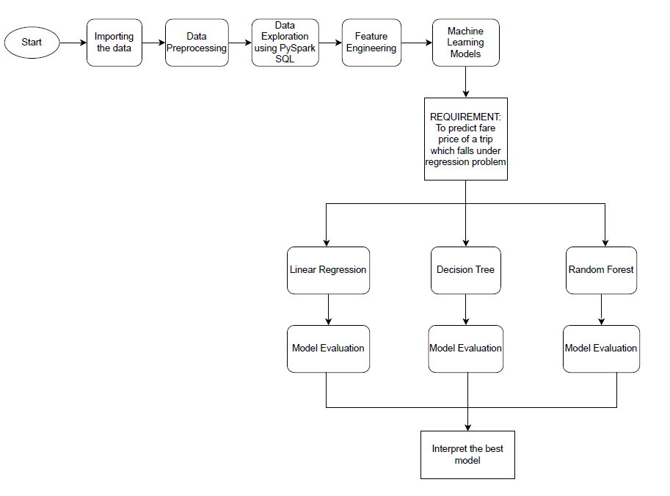
Data Flow Model

Slide 9
Linear regression Model
RMSE : 5.81
R-squared error : 0.75
*****************************
Decision Tree Model
RMSE : 5.30
R-squared error: 0.79
*****************************
Random Forest Model
RMSE : 5.47
R-squared error : 0.78
RESULT

Slide 10
Challenge
1
2
3
Large Dataset:
Over 1 Million Records
DateTime Challenges:
Handling Time
Imbalanced
Data

Slide 11
THANK YOU!
HADOOP HEROES

